Slide 1

Segmentation Techniques:
Super Pixelization
& Region Growth
12.10.2024
Bret & Aiden
PHYS 510

Slide 2
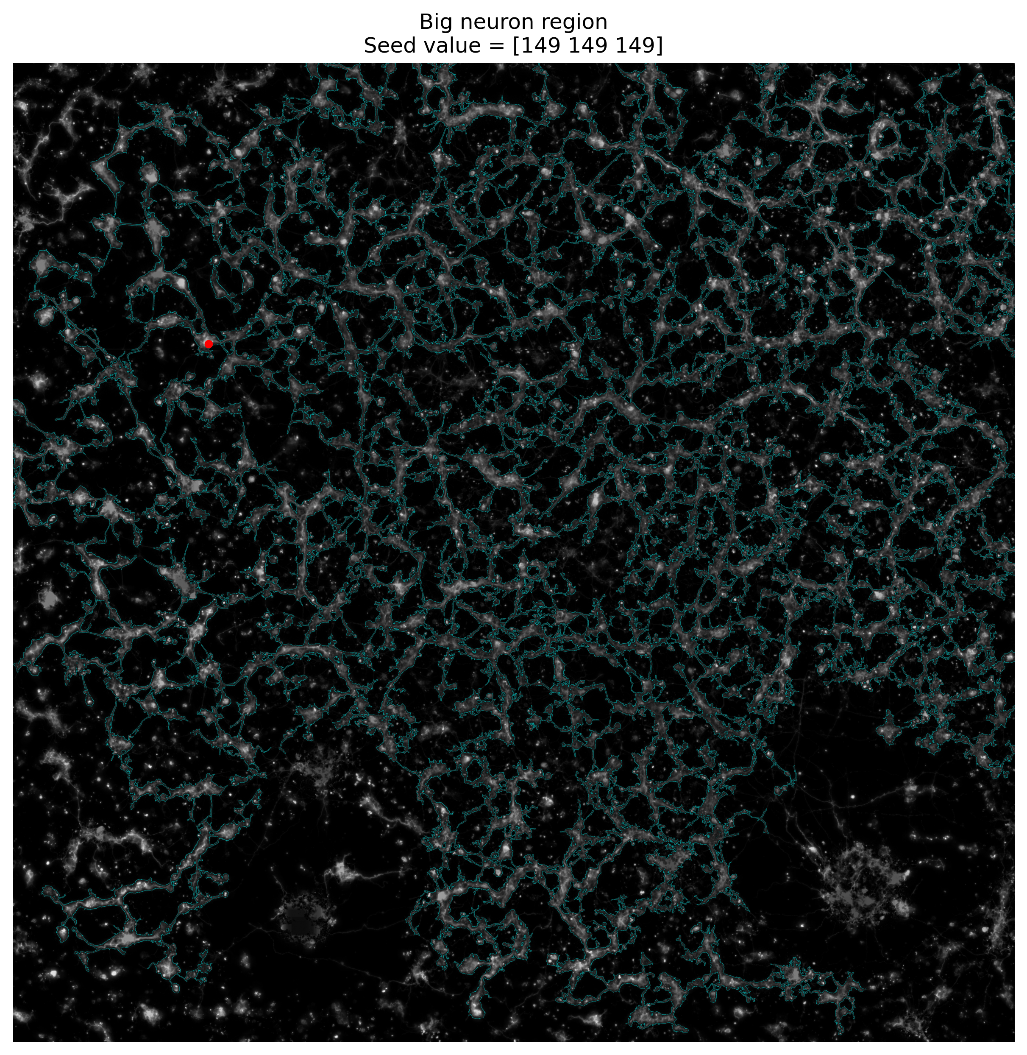
Overview
Throughout this presentation we’ll cover two big segmentation techniques
Superpixelization
Exploring k-means clustering & SLIC algorithm
Region Growth
Direct applications and examples
Combined pipeline
Conducting region growth on superpixelized images for decreased instability and computation times

Slide 3
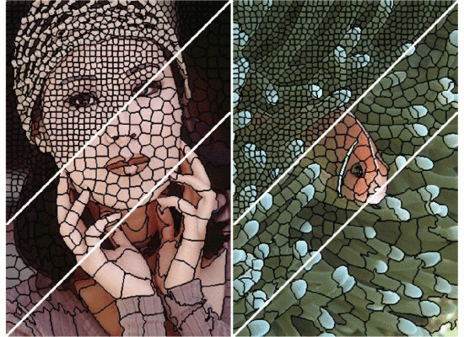
Image Segmentation and Superpixels
Image segmentation: partitioning an image into meaningful regions for easier analysis and interpretation.
Superpixelization: Replacing the rigid structure of individual pixels with delineated regions that preserve meaningful content in the image
By reducing the computational complexity and preserving essential image features, super-pixelization serves as a powerful preprocessing step that enhances the efficiency and accuracy of subsequent segmentation tasks.

Slide 4
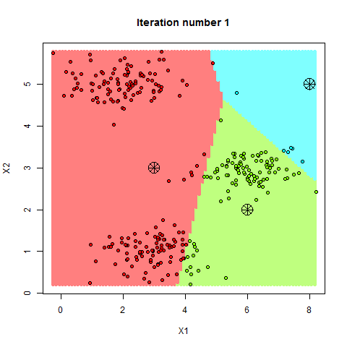
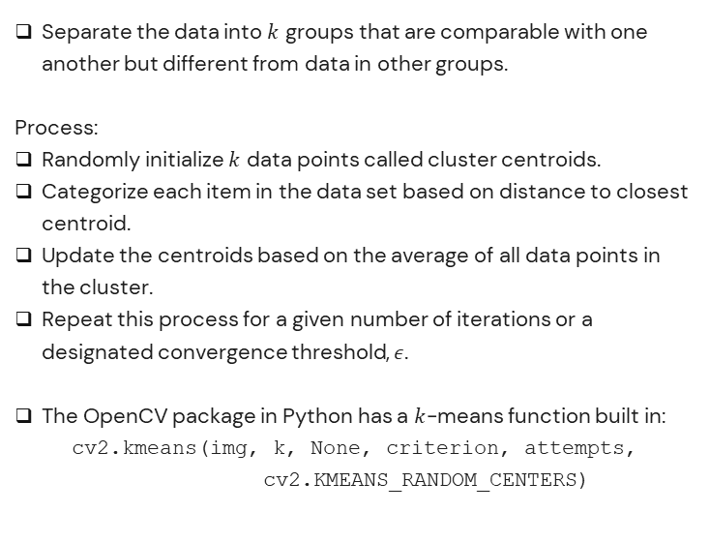
$k$-Means Clustering
Super-Pixelization: k-Means Clustering
Separate the data into $k$ groups that are comparable with one another but different from data in other groups.
Process:
Randomly initialize $k$ data points called cluster centroids.
Categorize each item in the data set based on distance to closest centroid.
Update the centroids based on the average of all data points in the cluster.
Repeat this process for a given number of iterations or a designated convergence threshold, $ε$.
The OpenCV package in Python has a $k$-means function built in:
cv2.kmeans(img, k, None, criterion, attempts, cv2.KMEANS_RANDOM_CENTERS)
Sandipan Dey, 2023, https://sandipanweb.wordpress.com

Slide 5
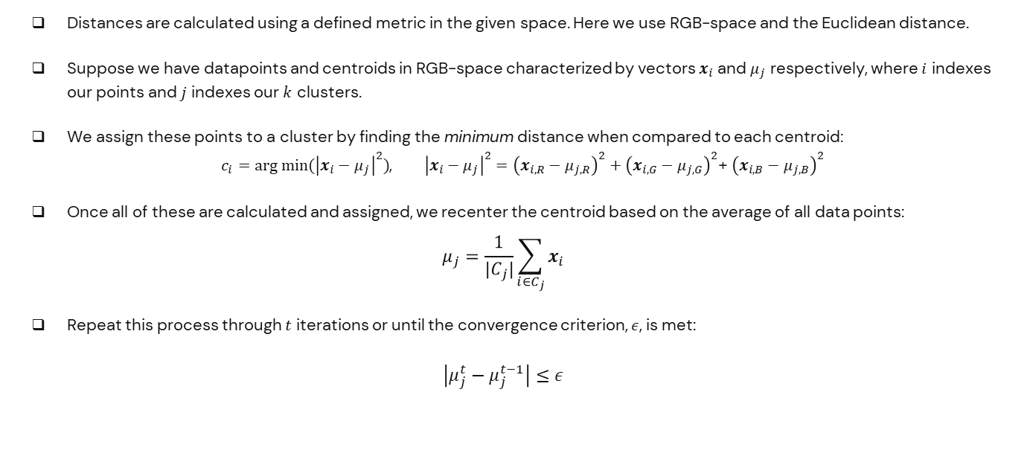
$k$-Means Clustering – ‘Distance’
Super-Pixelization: k-Means Clustering
Distances are calculated using a defined metric in the given space. Here we use RGB-space and the Euclidean distance.
Suppose we have datapoints and centroids in RGB-space characterized by vectors $x_{i}$ and $μ_{j}$ respectively, where $i$ indexes our points and $j$ indexes our $k$ clusters.
We assign these points to a cluster by finding the minimum distance when compared to each centroid:
$c_{i}=arg min⁡({\left|x_{i}−μ_{j}\right|}^{2})$, ${\left|x_{i}−μ_{j}\right|}^{2}={\left(x_{i,R}−μ_{j,R}\right)}^{2}+{\left(x_{i,G}−μ_{j,G}\right)}^{2}$+ ${\left(x_{i,B}−μ_{j,B}\right)}^{2}$
Once all of these are calculated and assigned, we recenter the centroid based on the average of all data points:
$$μ_{j}=\frac{1}{{|C}_{j}|}\sum_{i∈C_{j}}{x_{i}}$$
Repeat this process through $t$ iterations or until the convergence criterion, $ε$, is met:
$$\left|μ_{j}^{t}−μ_{j}^{t−1}\right|≤ε$$

Slide 6
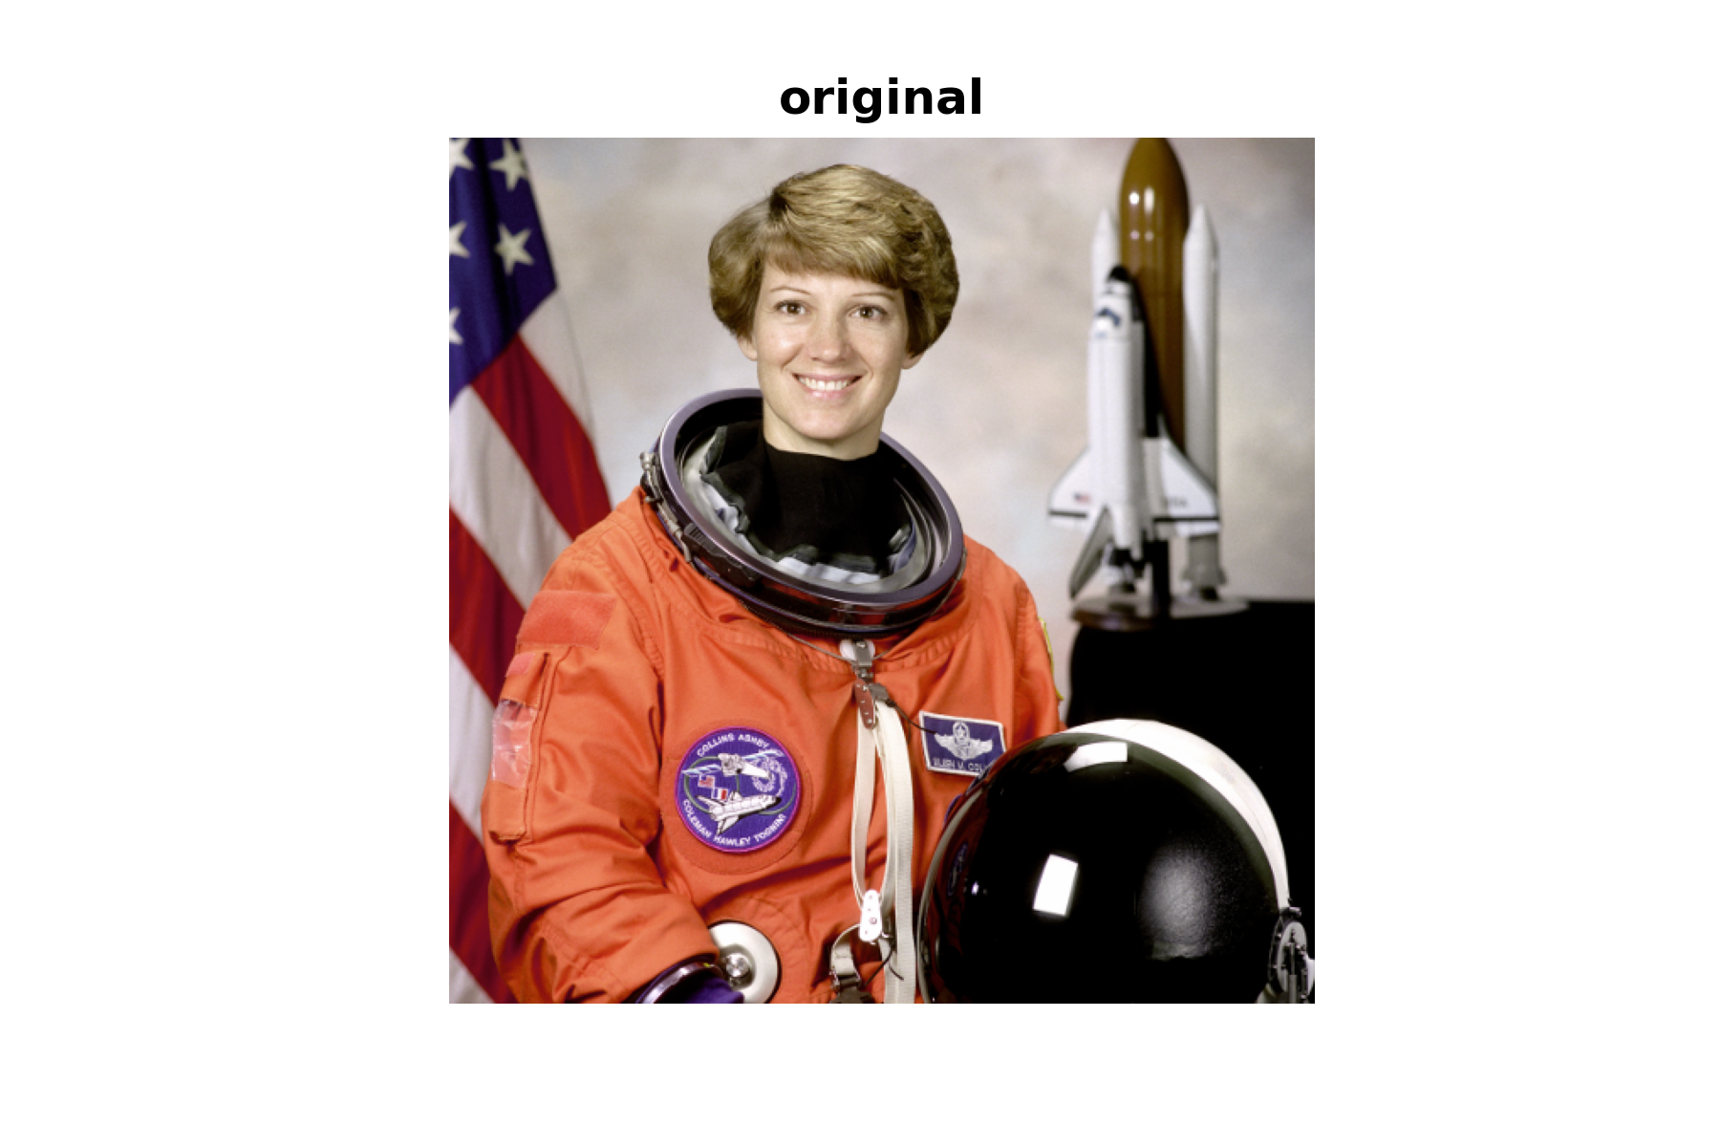
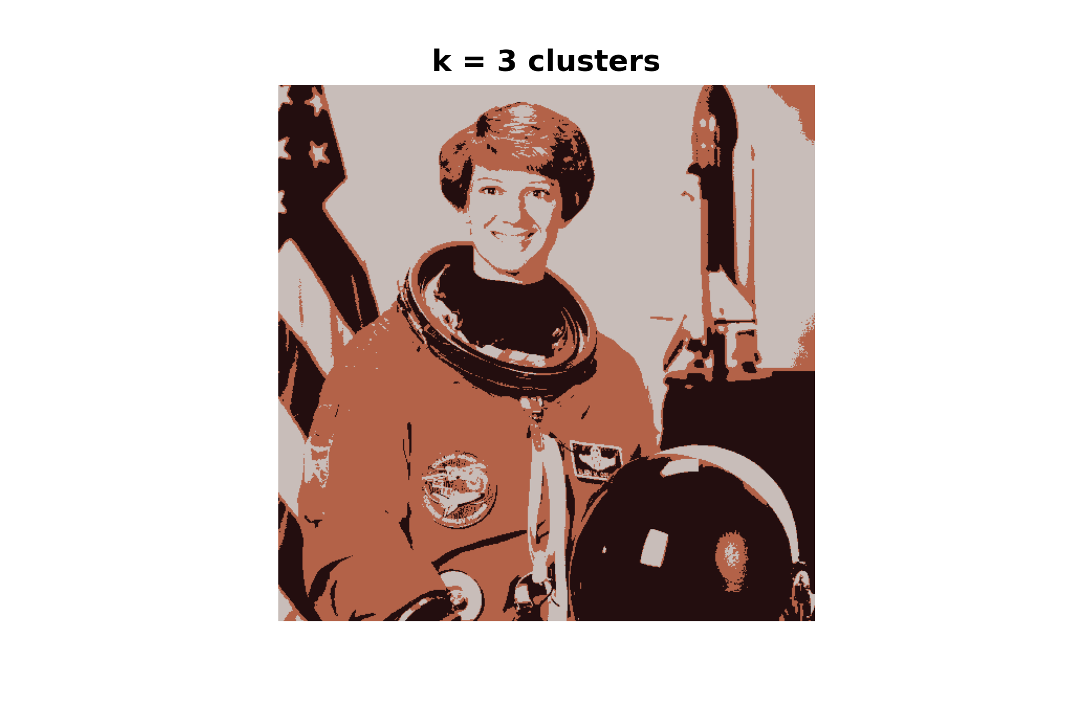
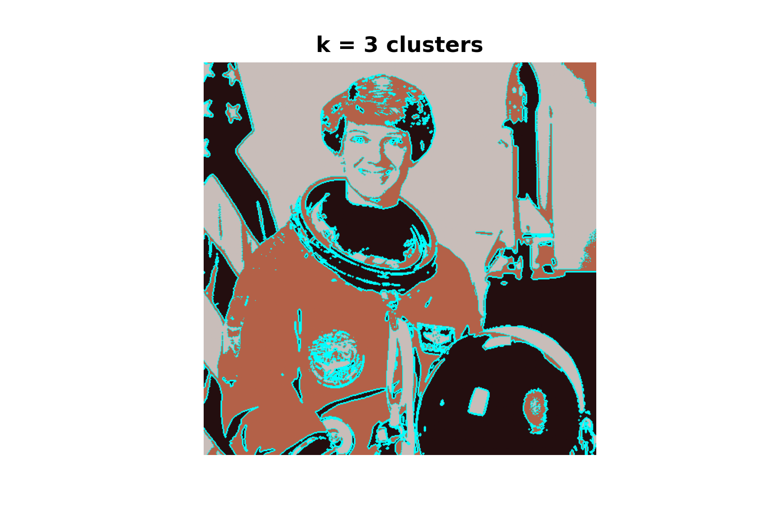
$k$-Means Clustering – Application
Super-Pixelization: k-Means Clustering

Slide 7
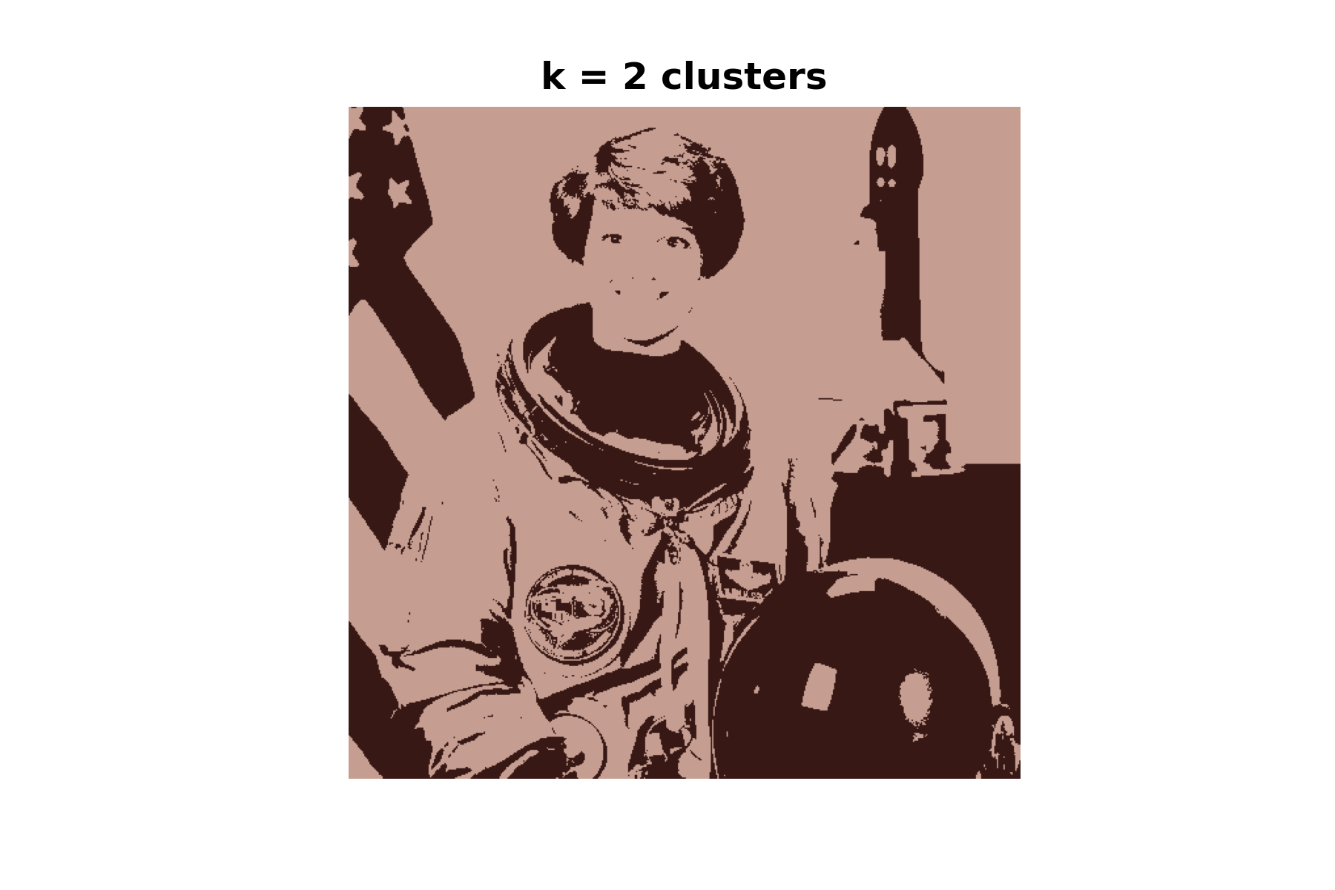

$k$-Means Clustering – Application
Super-Pixelization: k-Means Clustering

Slide 8

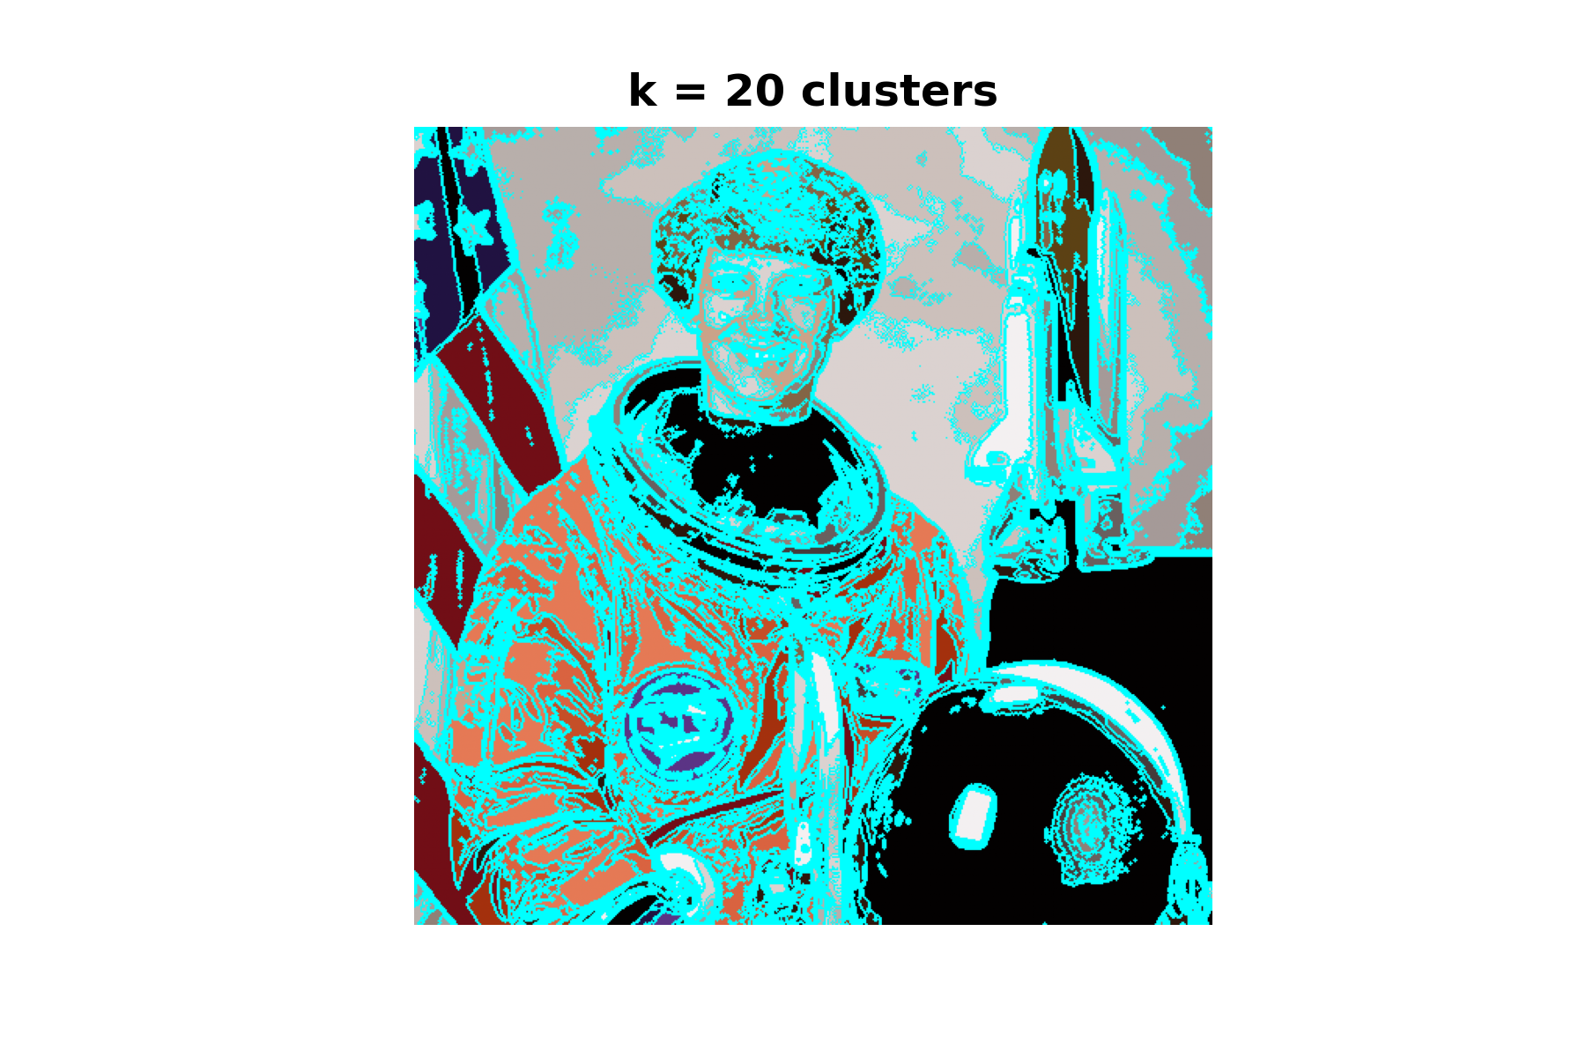
$k$-Means Clustering – Application
Super-Pixelization: k-Means Clustering

Slide 9
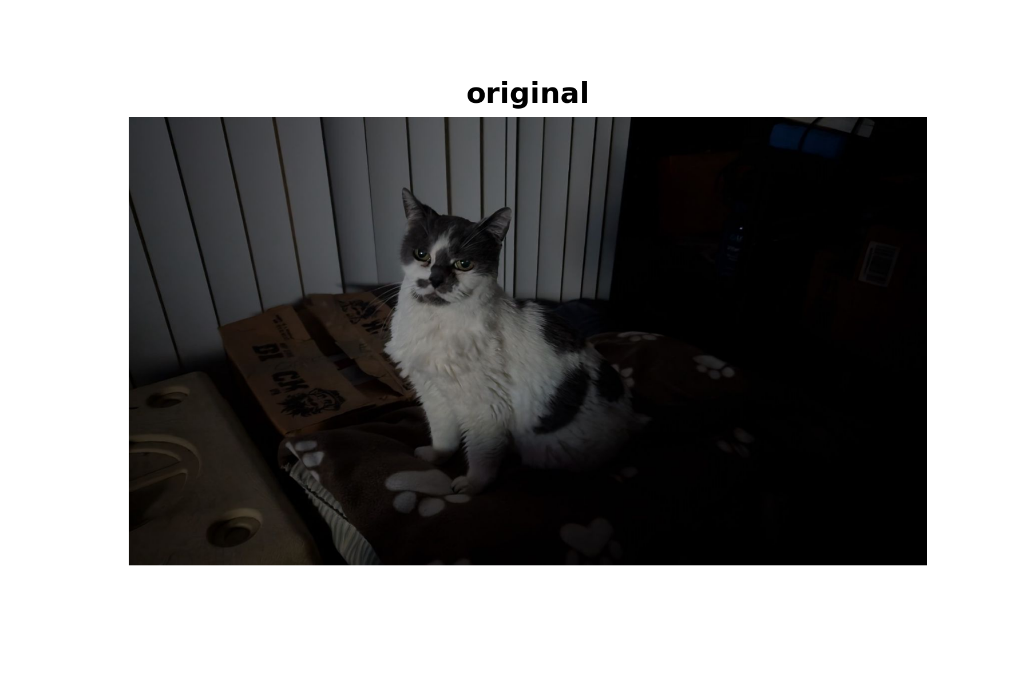
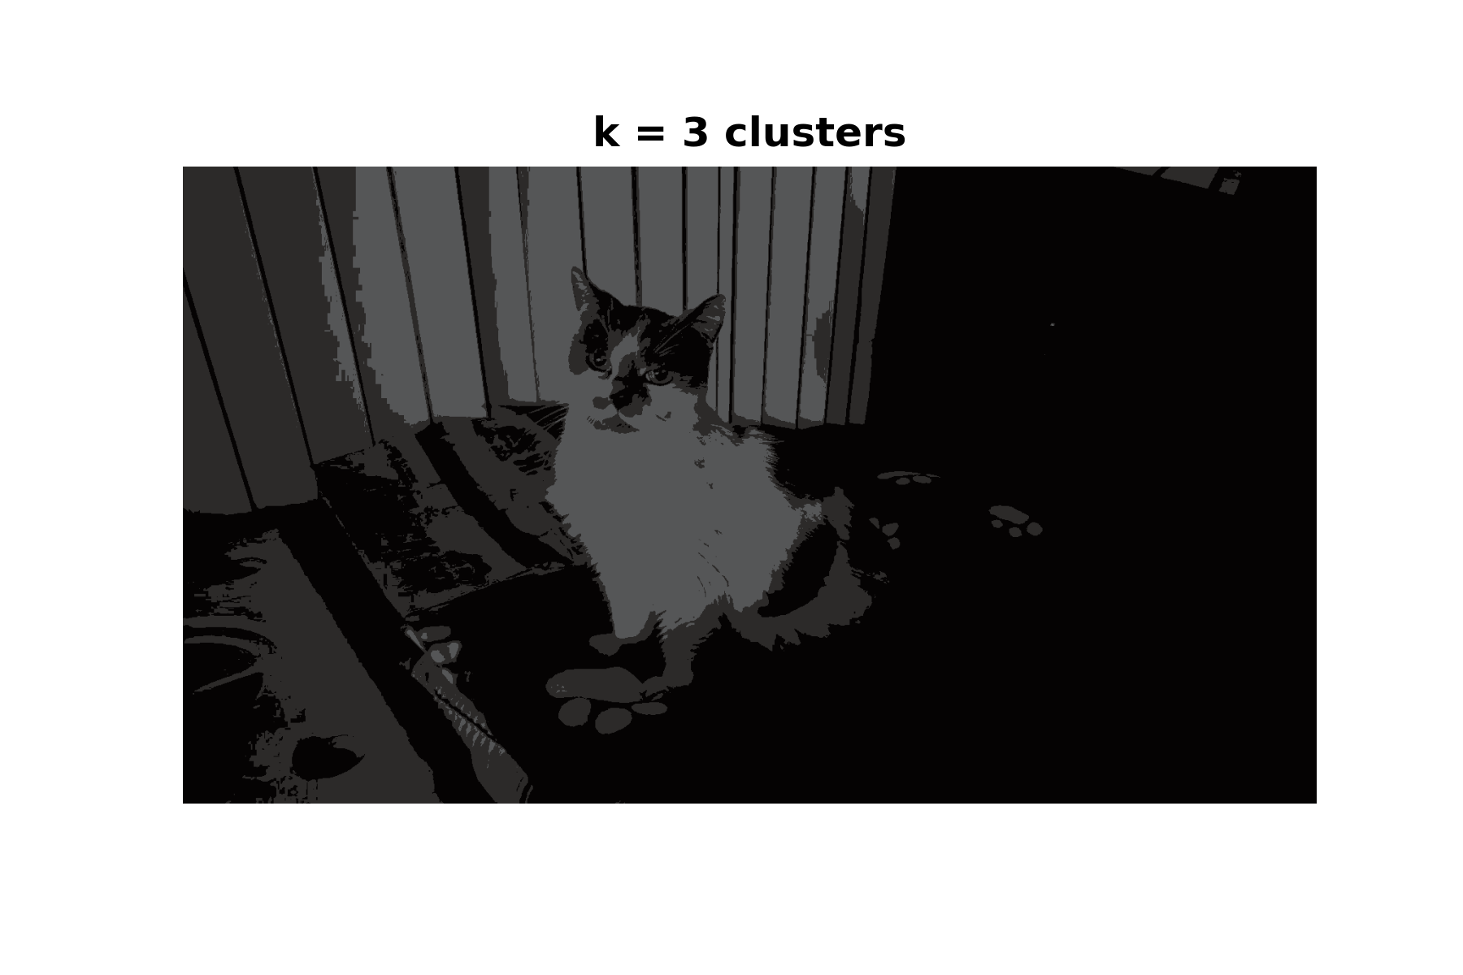
$k$-Means Clustering – Application
Super-Pixelization: k-Means Clustering

Slide 10
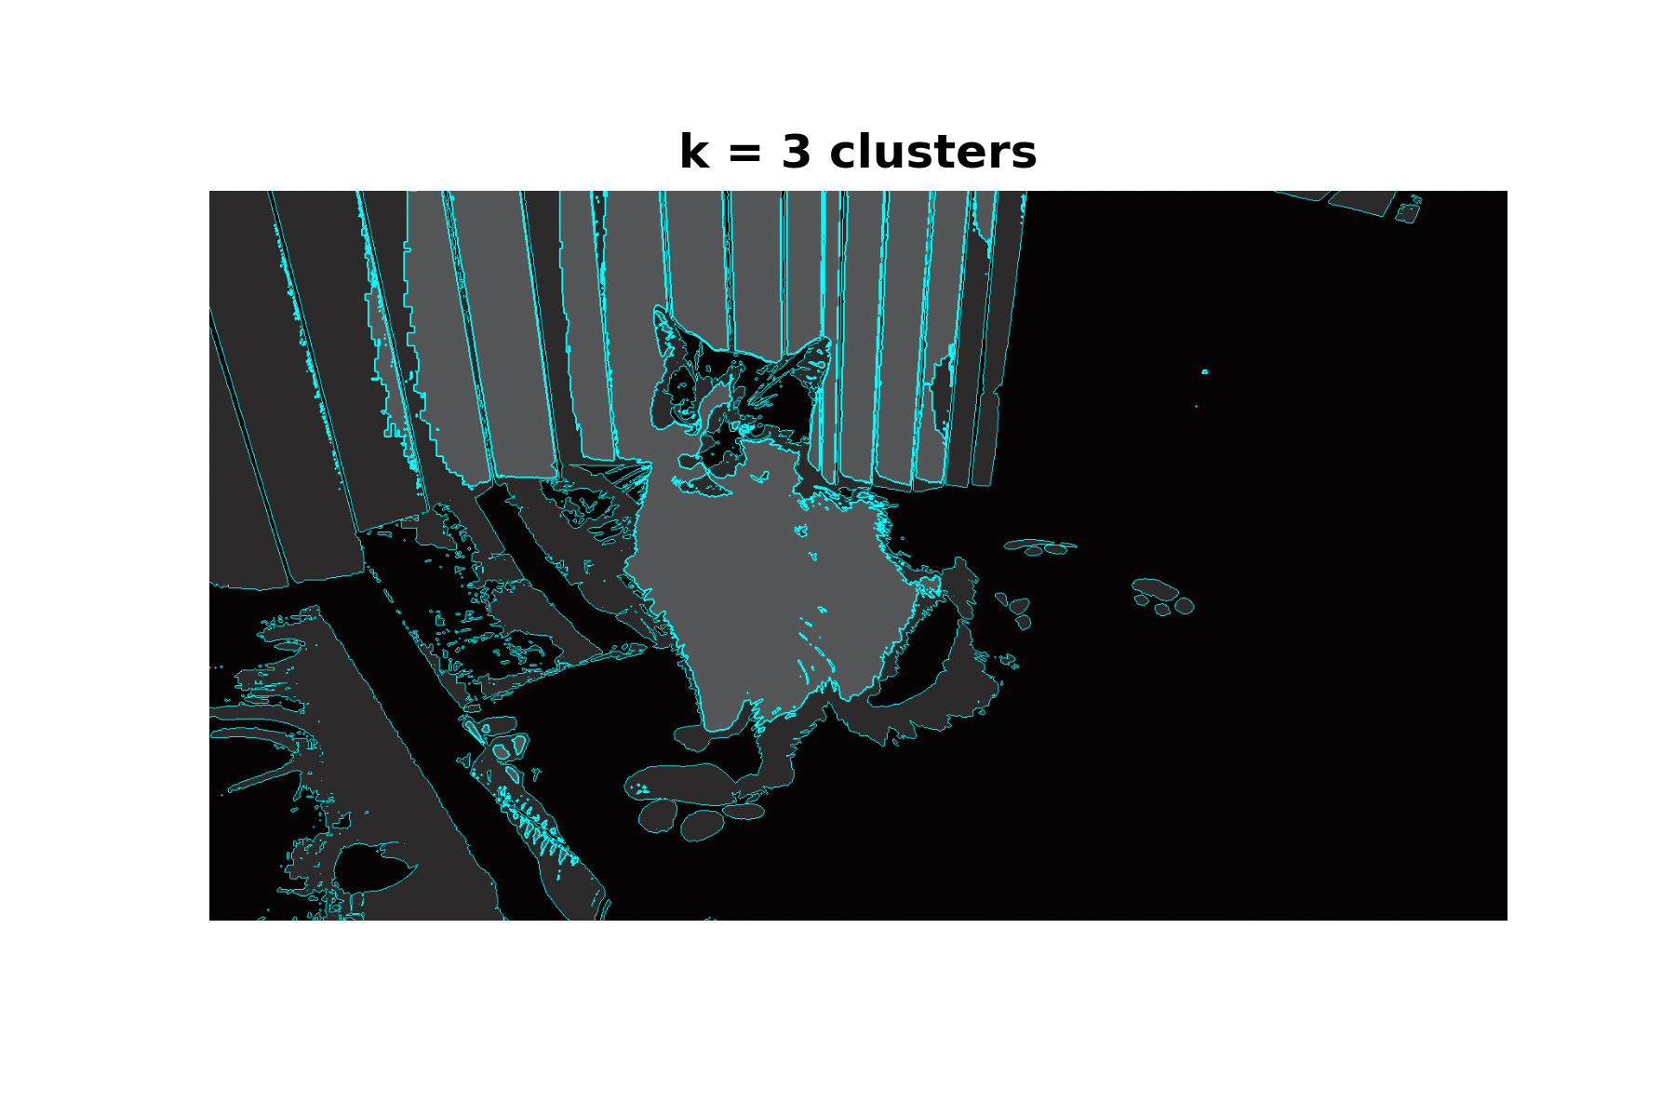
$k$-Means Clustering – Application
Super-Pixelization: k-Means Clustering

Slide 11
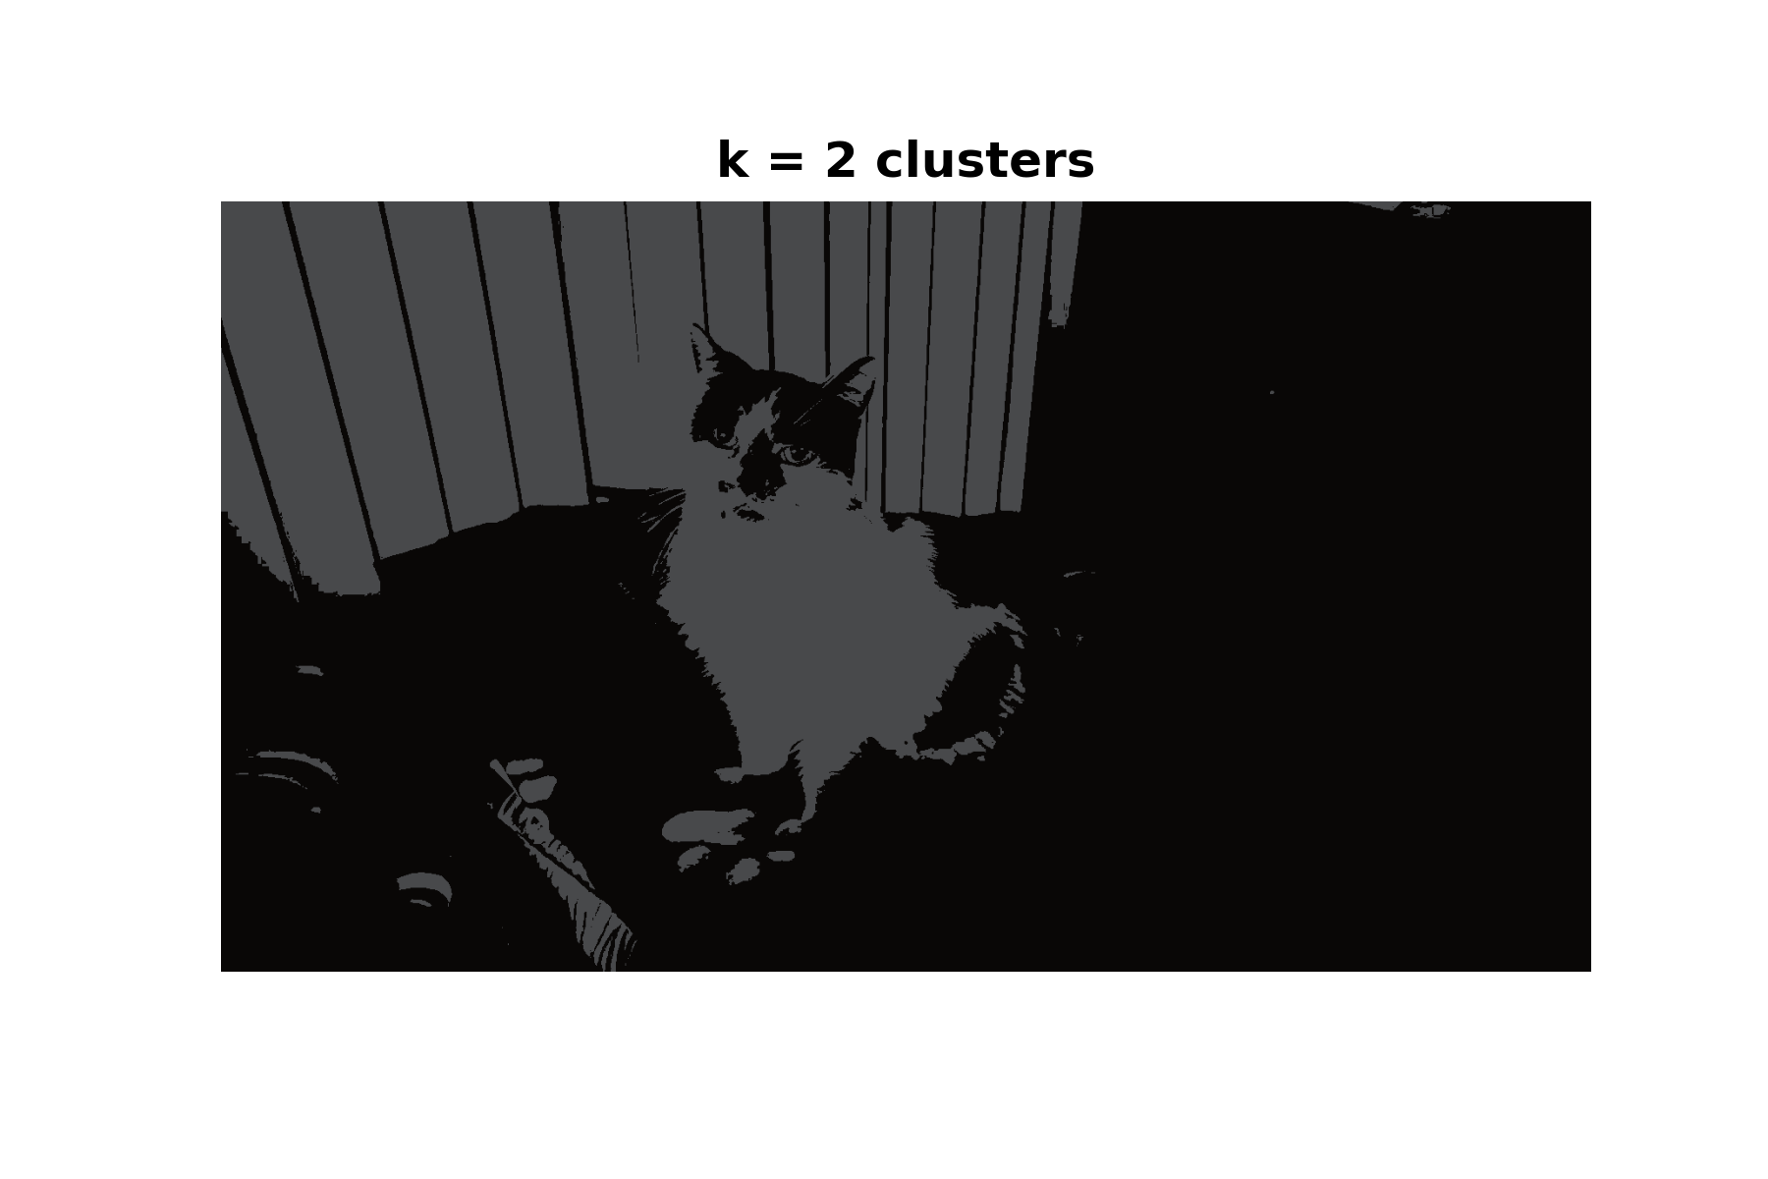
$k$-Means Clustering – Application
Super-Pixelization: k-Means Clustering

Slide 12
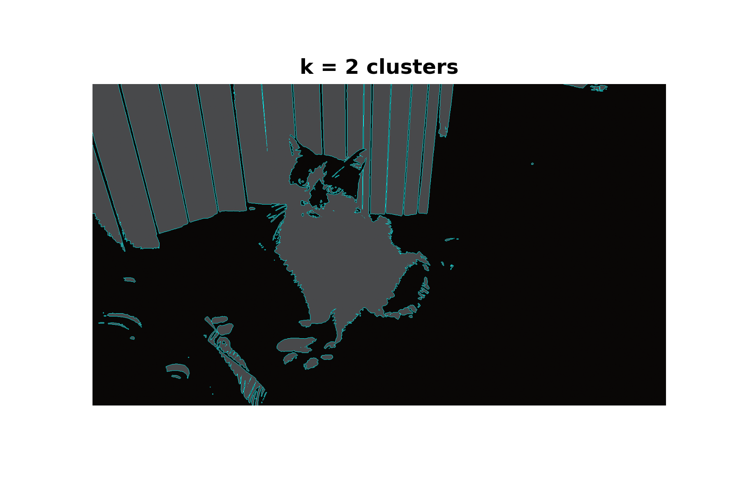
$k$-Means Clustering – Application
Super-Pixelization: k-Means Clustering

Slide 13
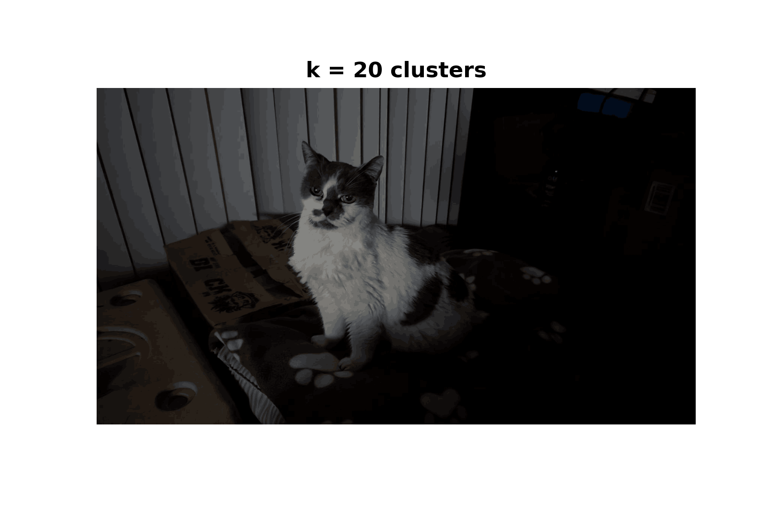
$k$-Means Clustering – Application
Super-Pixelization: k-Means Clustering

Slide 14
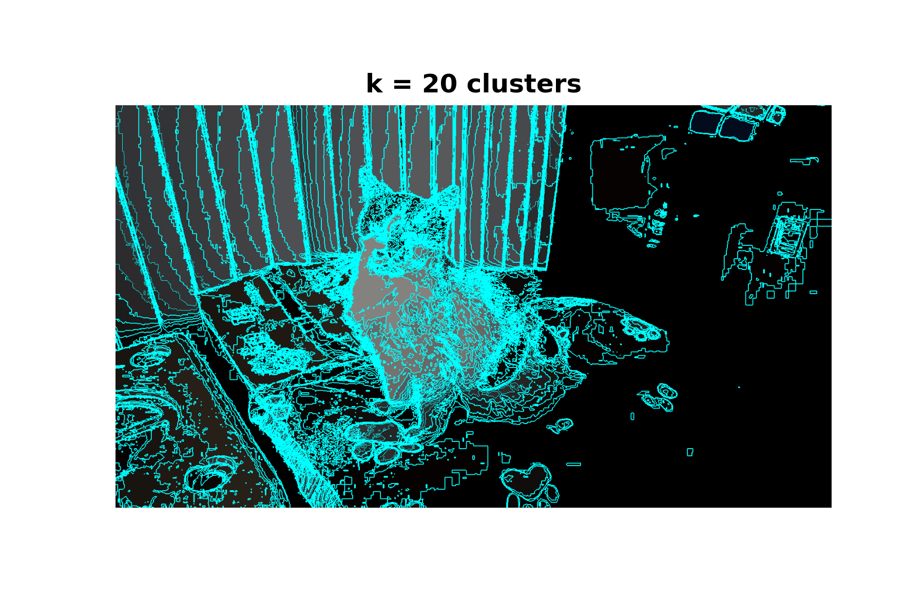
$k$-Means Clustering – Application
Super-Pixelization: k-Means Clustering

Slide 15
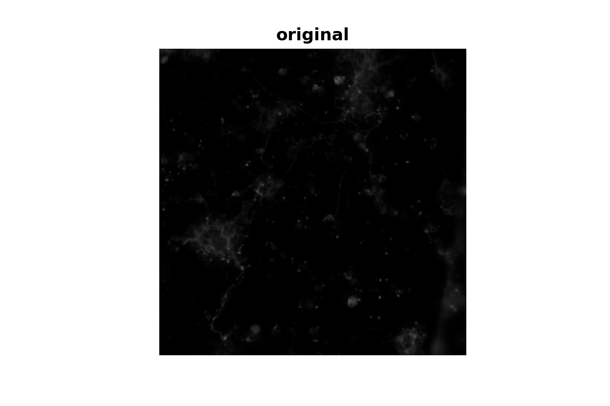

$k$-Means Clustering – Application
Super-Pixelization: k-Means Clustering

Slide 16
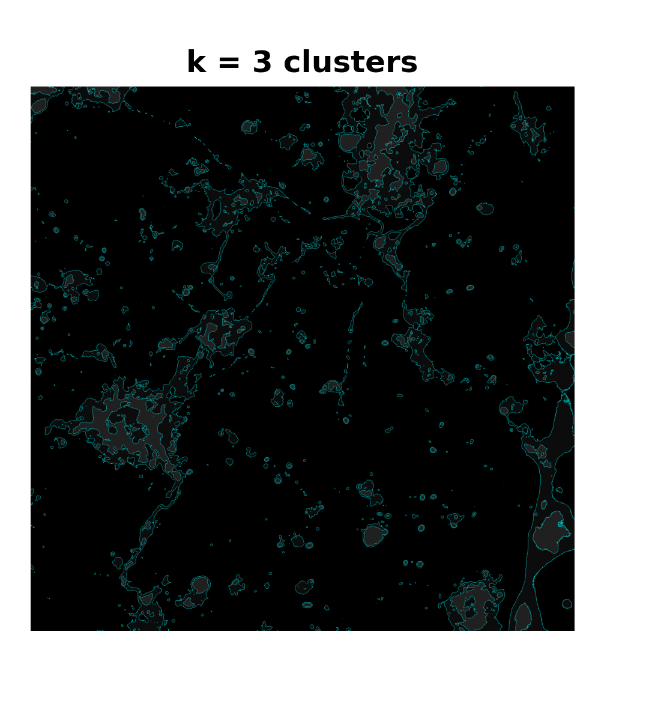
$k$-Means Clustering – Application
Super-Pixelization: k-Means Clustering

Slide 17

$k$-Means Clustering – Application
Super-Pixelization: k-Means Clustering

Slide 18
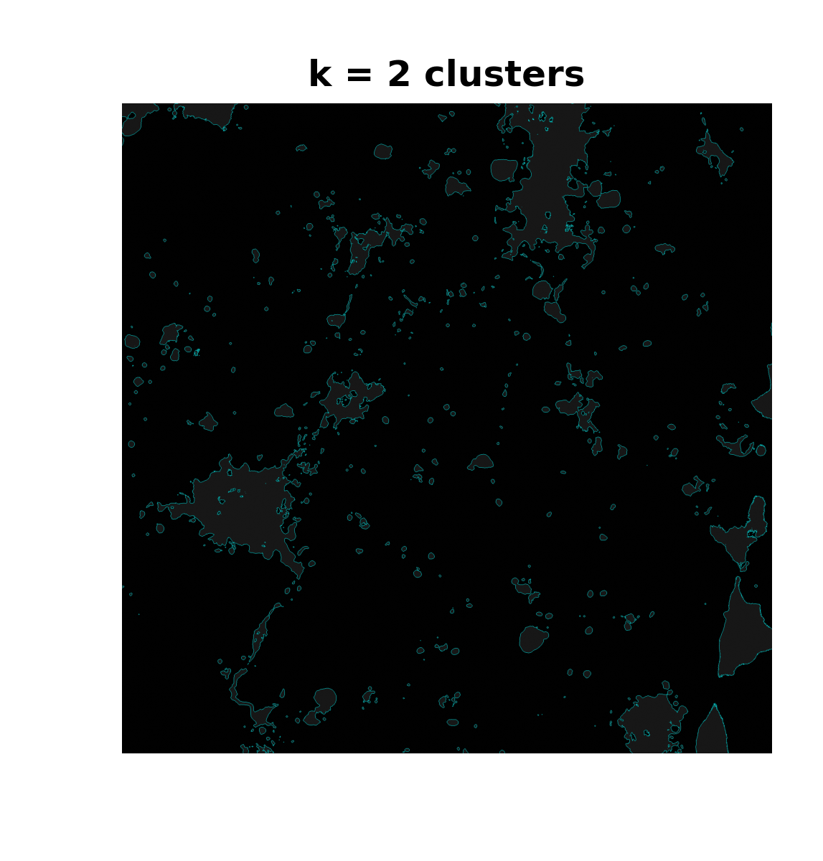
$k$-Means Clustering – Application
Super-Pixelization: k-Means Clustering

Slide 19
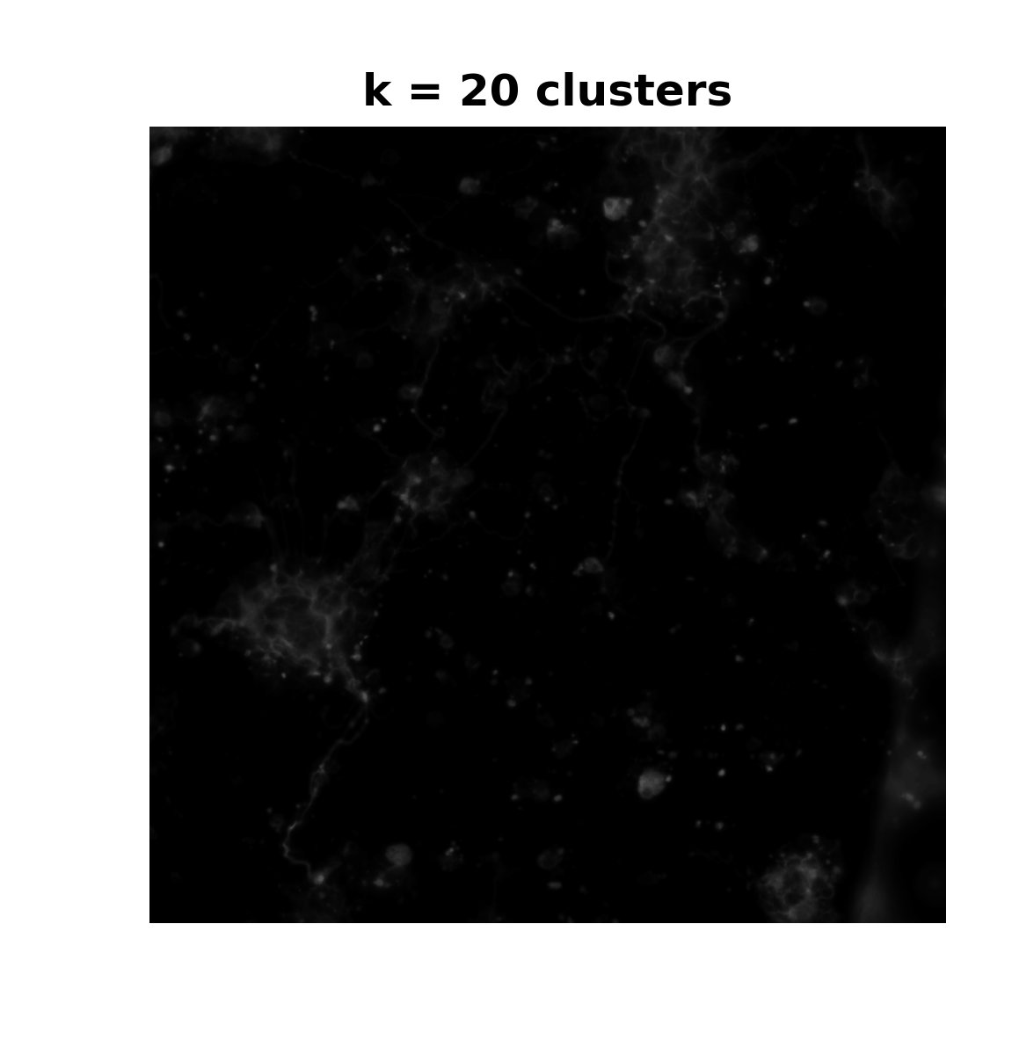
$k$-Means Clustering – Application
Super-Pixelization: k-Means Clustering

Slide 20
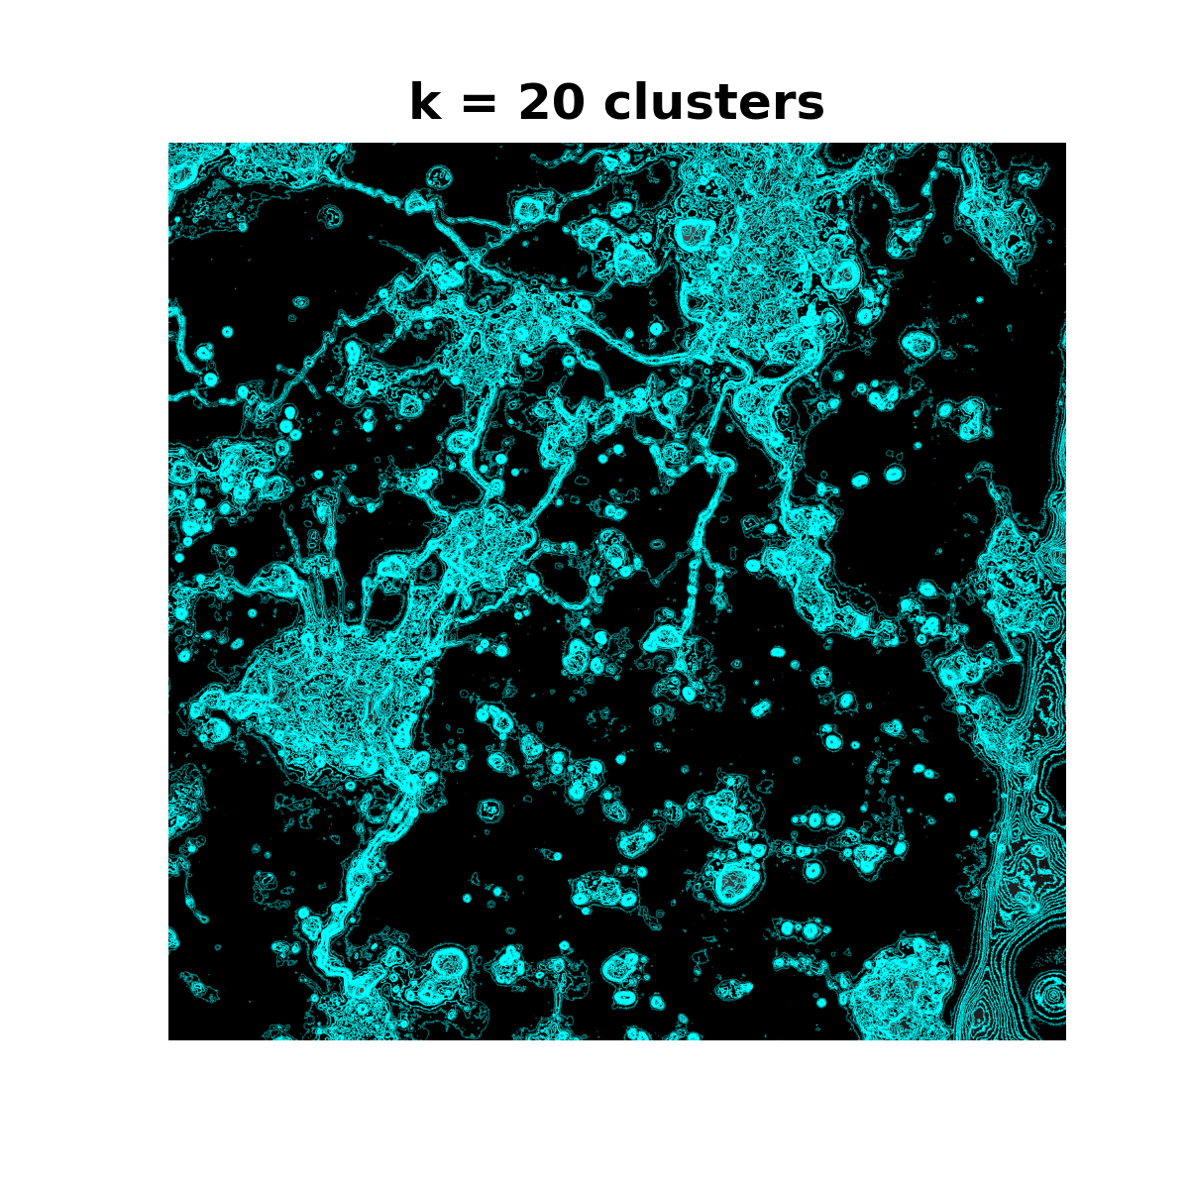
$k$-Means Clustering – Application
Super-Pixelization: k-Means Clustering

Slide 21
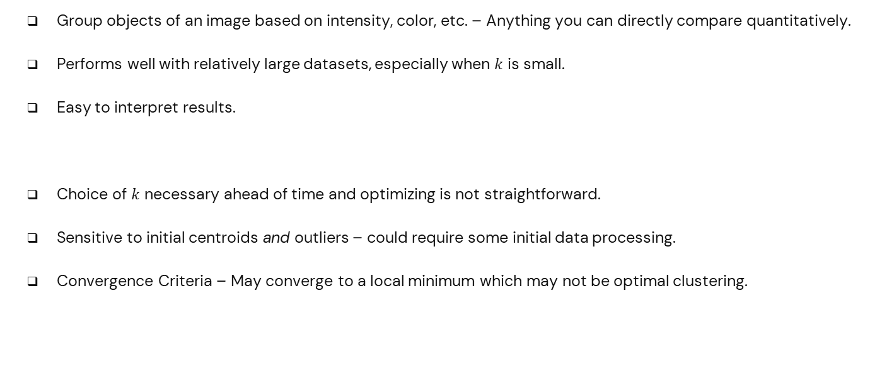
$k$-Means Clustering – (Dis)Advantages
Super-Pixelization: k-Means Clustering
Group objects of an image based on intensity, color, etc. – Anything you can directly compare quantitatively.
Performs well with relatively large datasets, especially when $k$ is small.
Easy to interpret results.
Choice of $k$ necessary ahead of time and optimizing is not straightforward.
Sensitive to initial centroids and outliers – could require some initial data processing.
Convergence Criteria – May converge to a local minimum which may not be optimal clustering.

Slide 22
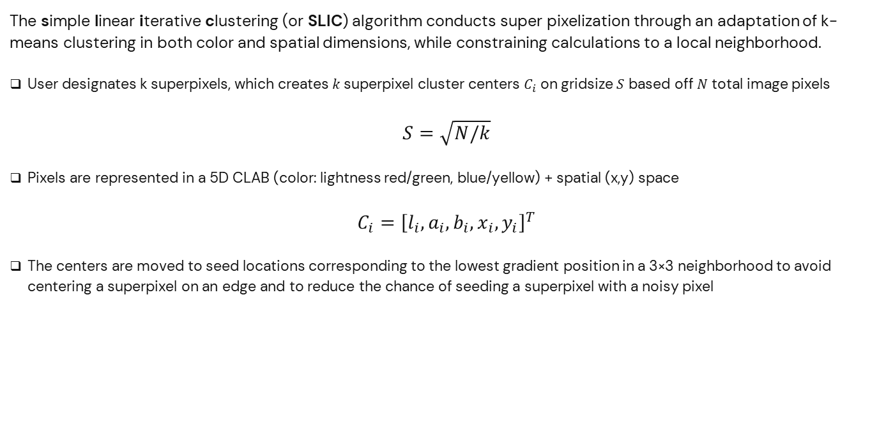
SLIC — Initilization
Super-Pixelization: SLIC Algorithm
The simple linear iterative clustering (or SLIC) algorithm conducts super pixelization through an adaptation of k-means clustering in both color and spatial dimensions, while constraining calculations to a local neighborhood.
User designates k superpixels, which creates$k$superpixel cluster centers $C_{i}$ on gridsize $S$ based off $N$ total image pixels
$$S=\sqrt{N/k}$$
Pixels are represented in a 5D CLAB (color: lightness red/green, blue/yellow) + spatial (x,y) space
$$C_{i}={\left[l_{i},a_{i},b_{i},x_{i},y_{i}\right]}^{T}$$
The centers are moved to seed locations corresponding to the lowest gradient position in a 3×3 neighborhood to avoid centering a superpixel on an edge and to reduce the chance of seeding a superpixel with a noisy pixel

Slide 23
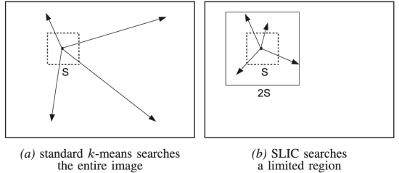
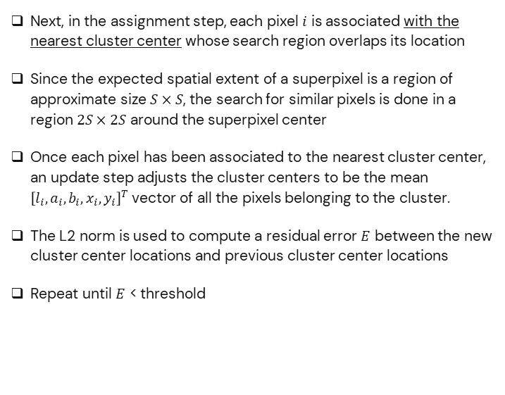
SLIC — Iterative Clustering
Super-Pixelization: SLIC Algorithm
Next, in the assignment step, each pixel $i$ is associated with the nearest cluster center whose search region overlaps its location
Since the expected spatial extent of a superpixel is a region of approximate size $S×S$, the search for similar pixels is done in a region $2S×2S$ around the superpixel center
Once each pixel has been associated to the nearest cluster center, an update step adjusts the cluster centers to be the mean ${\left[l_{i},a_{i},b_{i},x_{i},y_{i}\right]}^{T}$vector of all the pixels belonging to the cluster.
The L2 norm is used to compute a residual error $E$ between the new cluster center locations and previous cluster center locations
Repeat until $E$ < threshold
Designated cluster centers, with localized neighborhoods for superpixel construction speeds up computation and makes SLIC’s complexity independent of the number of image pixels

Slide 24
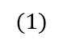
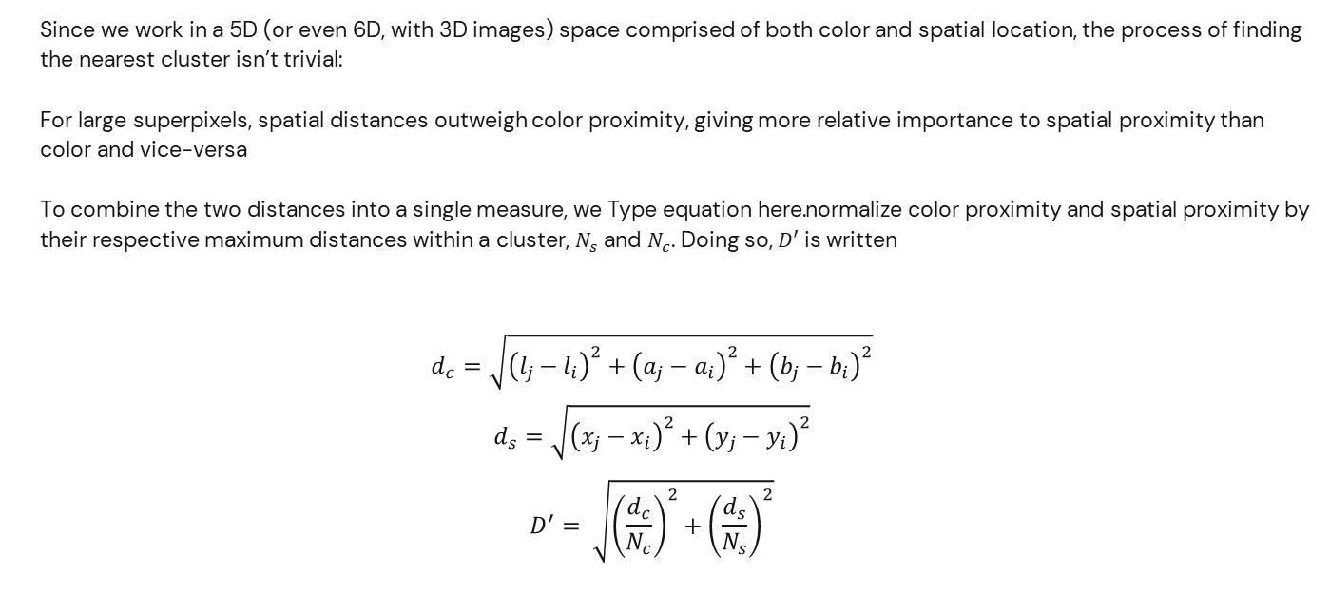
SLIC — Distance Measure D
Super-Pixelization: SLIC Algorithm
Since we work in a 5D (or even 6D, with 3D images) space comprised of both color and spatial location, the process of finding the nearest cluster isn’t trivial:
For large superpixels, spatial distances outweigh color proximity, giving more relative importance to spatial proximity than color and vice-versa
To combine the two distances into a single measure, we normalize color proximity and spatial proximity by their respective maximum distances within a cluster, $N_{s}$ and $N_{c}$. Doing so, $D′$ is written
$$d_{c}=\sqrt{{\left(l_{j}−l_{i}\right)}^{2}+{\left(a_{j}−a_{i}\right)}^{2}+{\left(b_{j}−b_{i}\right)}^{2}}$$
$$d_{s}=\sqrt{{\left(x_{j}−x_{i}\right)}^{2}+{\left(y_{j}−y_{i}\right)}^{2}}$$
$$D^{′}= \sqrt{{\left(\frac{d_{c}}{N_{c}}\right)}^{2}+{\left(\frac{d_{s}}{N_{s}}\right)}^{2}}$$
$$(1)$$

Slide 25
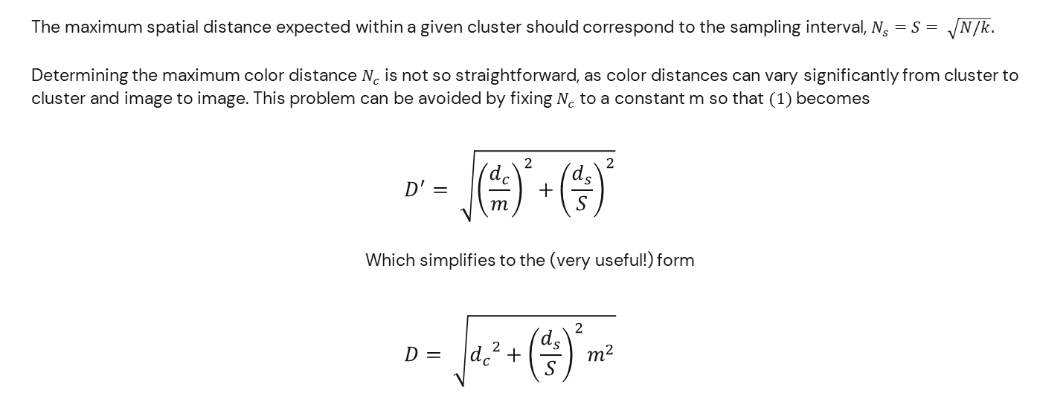
SLIC — Distance Measure D cont.
Super-Pixelization: SLIC Algorithm
The maximum spatial distance expected within a given cluster should correspond to the sampling interval, $N_{s}=S= \sqrt{N/k}.$
Determining the maximum color distance $N_{c}$ is not so straightforward, as color distances can vary significantly from cluster to cluster and image to image. This problem can be avoided by fixing $N_{c}$ to a constant m so that $(1)$becomes
$$D^{′}= \sqrt{{\left(\frac{d_{c}}{m}\right)}^{2}+{\left(\frac{d_{s}}{S}\right)}^{2}}$$
Which simplifies to the (very useful!) form
$$D= \sqrt{{d_{c}}^{2}+{\left(\frac{d_{s}}{S}\right)}^{2}m^{2}}$$

Slide 26
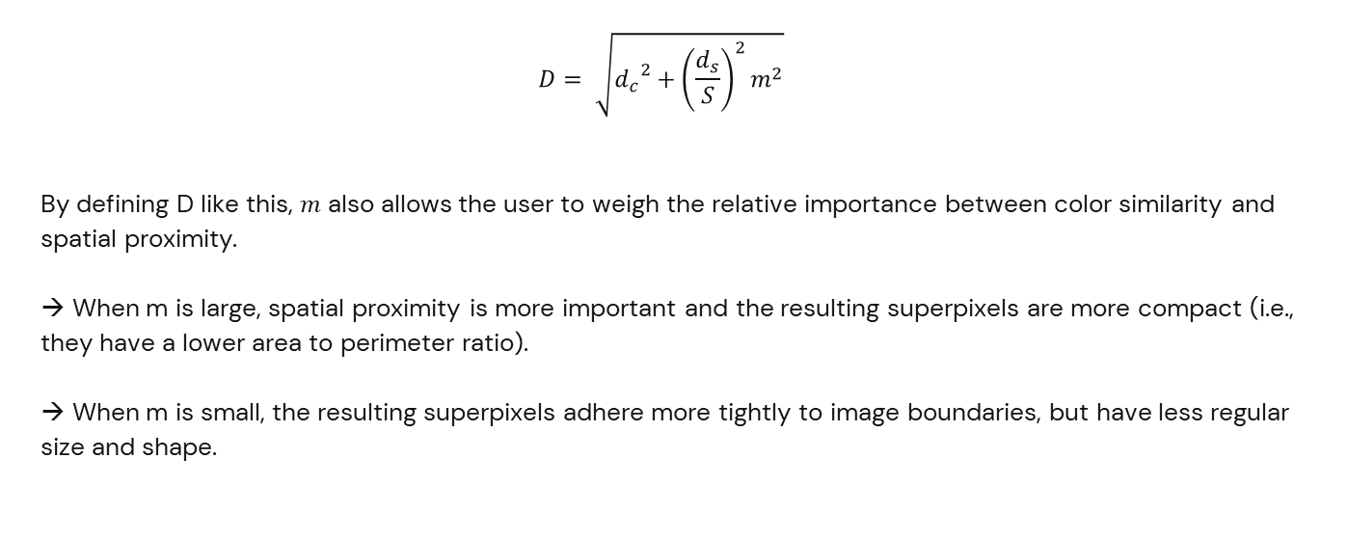
SLIC — Distance Measure D cont.²
Super-Pixelization: SLIC Algorithm
$$D= \sqrt{{d_{c}}^{2}+{\left(\frac{d_{s}}{S}\right)}^{2}m^{2}}$$
By defining D like this, $m$ also allows the user to weigh the relative importance between color similarity and spatial proximity.
→ When m is large, spatial proximity is more important and the resulting superpixels are more compact (i.e., they have a lower area to perimeter ratio).
→ When m is small, the resulting superpixels adhere more tightly to image boundaries, but have less regular size and shape.

Slide 27
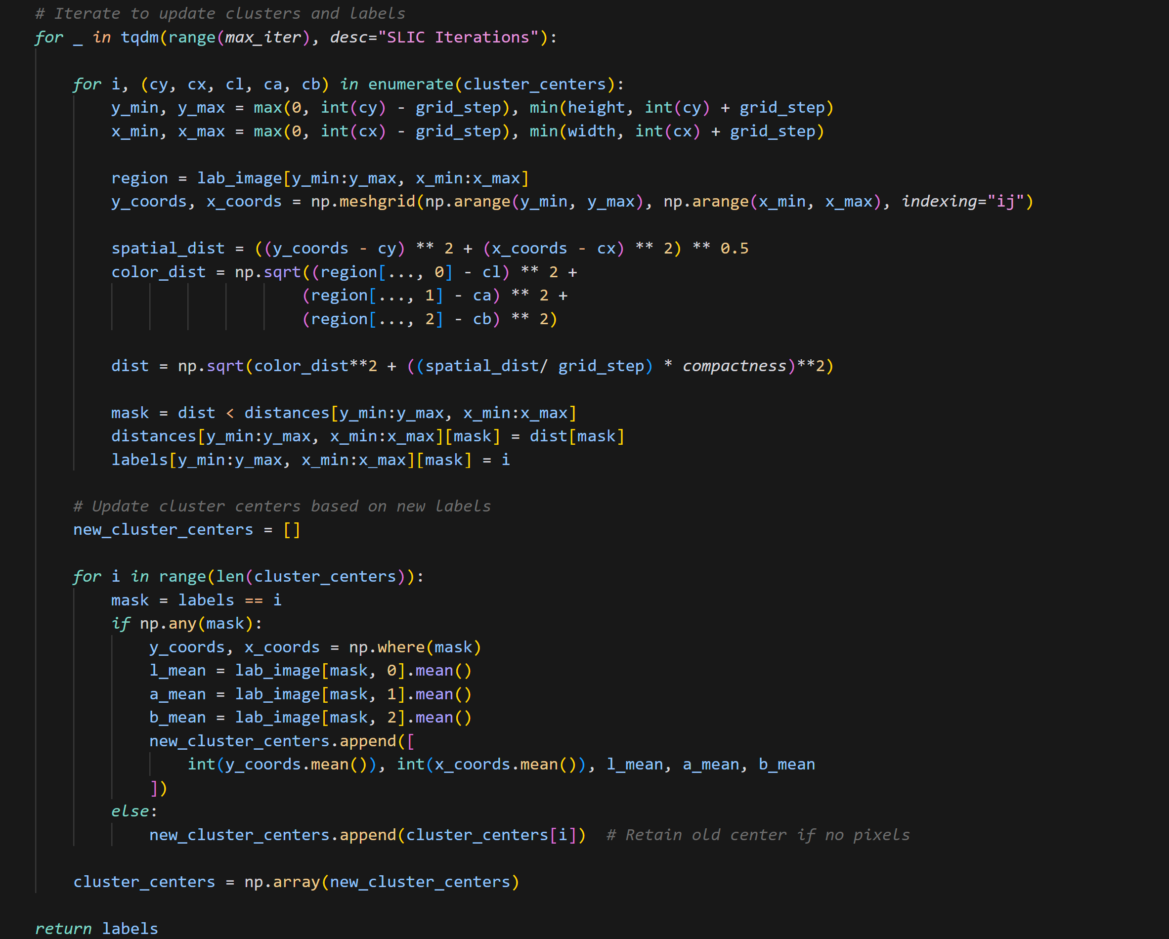
SLIC — Main Loop
Super-Pixelization: SLIC Algorithm

Slide 28
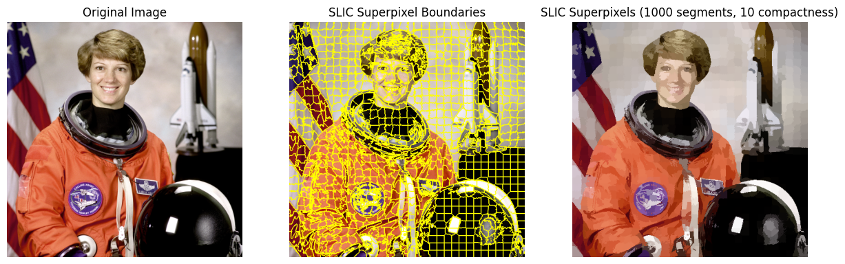
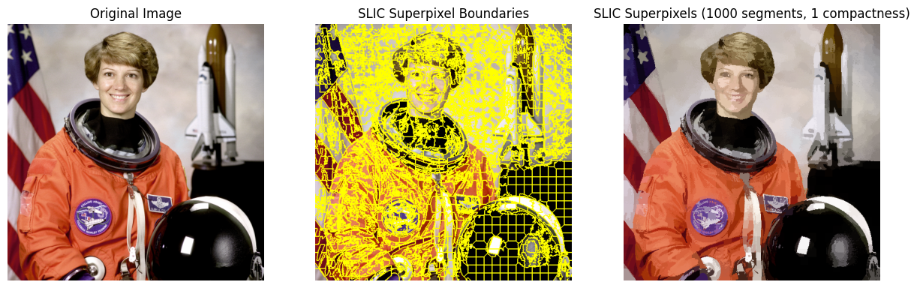
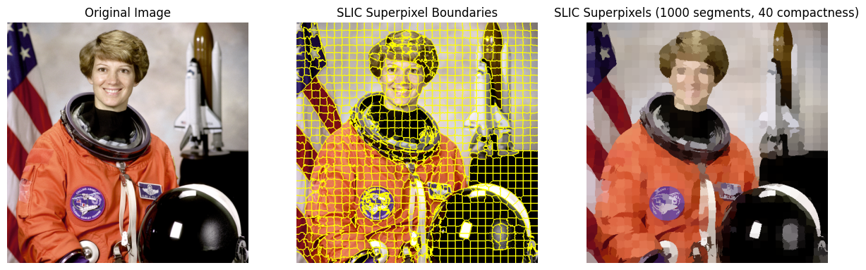
SLIC Example — Varying $m$
Super-Pixelization: SLIC Algorithm

Slide 29
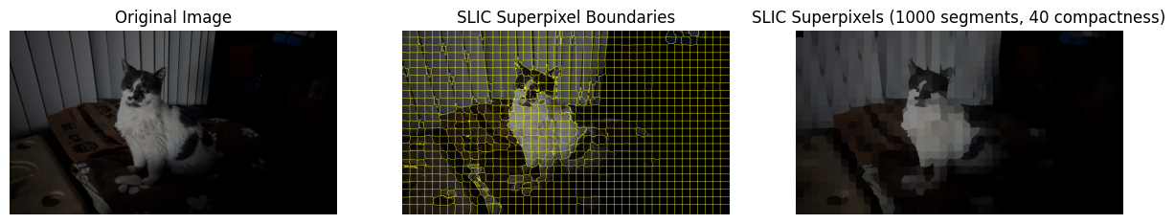

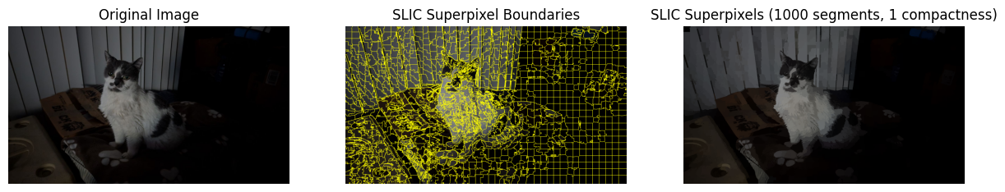
SLIC Example — Varying $m$ cont.
Super-Pixelization: SLIC Algorithm

Slide 30
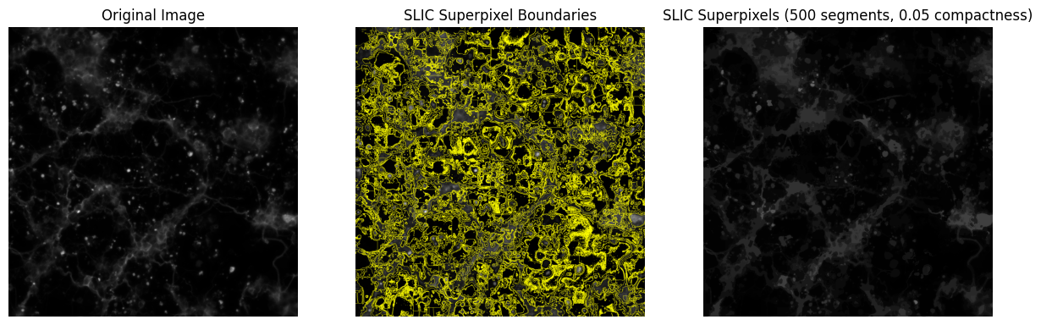
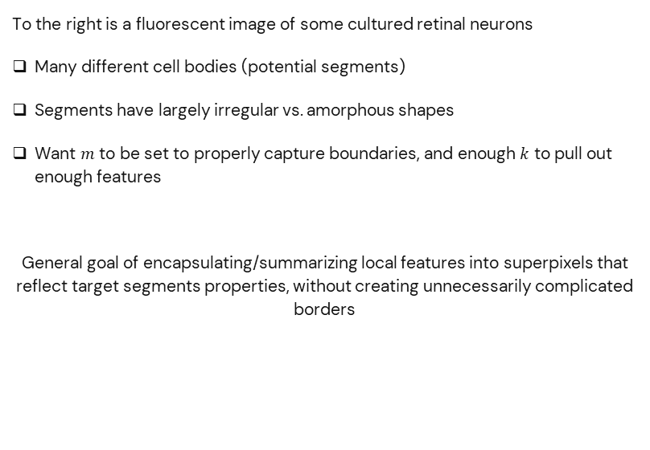
SLIC — Balancing $k$ and $m$
Super-Pixelization: SLIC Algorithm
To the right is a fluorescent image of some cultured retinal neurons
Many different cell bodies (potential segments)
Segments have largely irregular vs. amorphous shapes
Want $m$ to be set to properly capture boundaries, and enough $k$ to pull out enough features
General goal of encapsulating/summarizing local features into superpixels that reflect target segments properties, without creating unnecessarily complicated borders

Slide 31
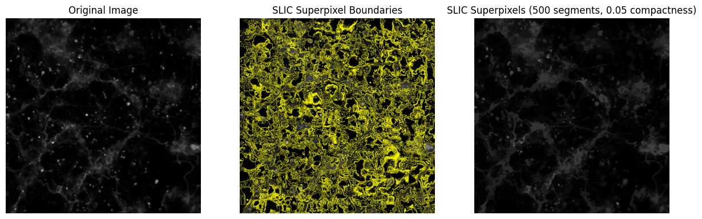
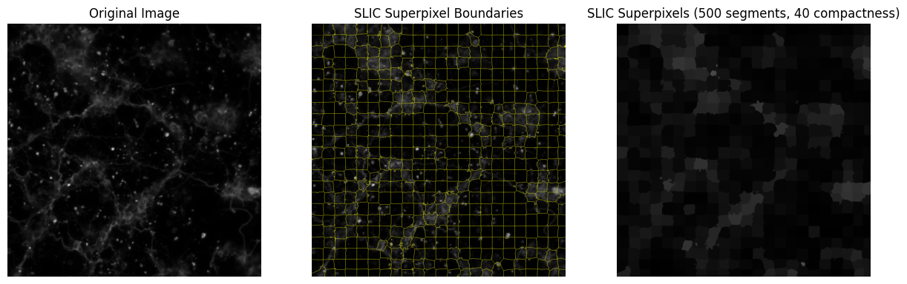
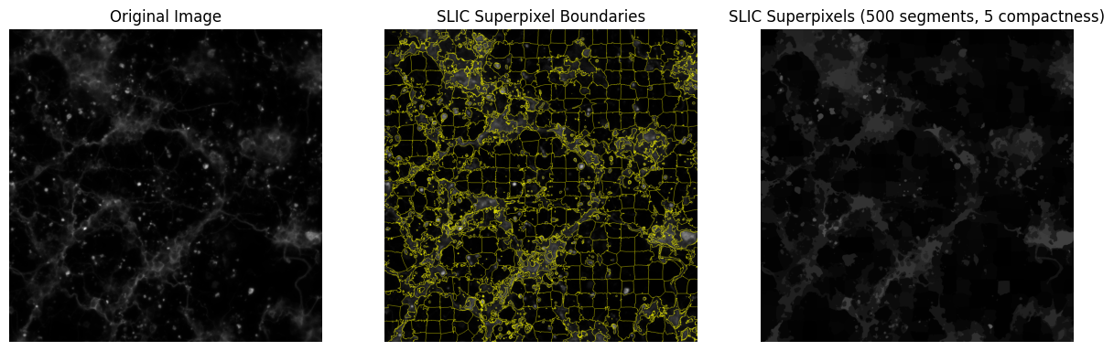
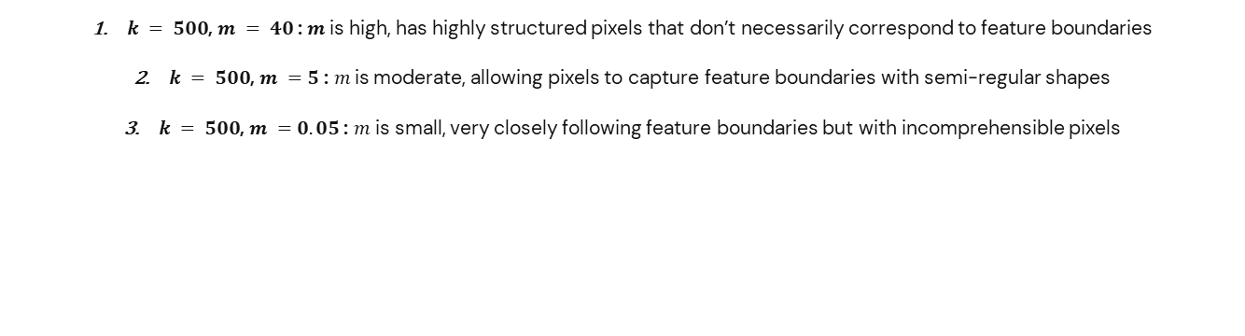
SLIC — Balancing $k$ and $m$
Super-Pixelization: SLIC Algorithm
$k = 500$, $m = 40$ : $m$ is high, has highly structured pixels that don’t necessarily correspond to feature boundaries
$k = 500$, $m =5$ : $m$is moderate, allowing pixels to capture feature boundaries with semi-regular shapes
$k = 500$, $m =0.05$ : $m$ is small, very closely following feature boundaries but with incomprehensible pixels

Slide 32
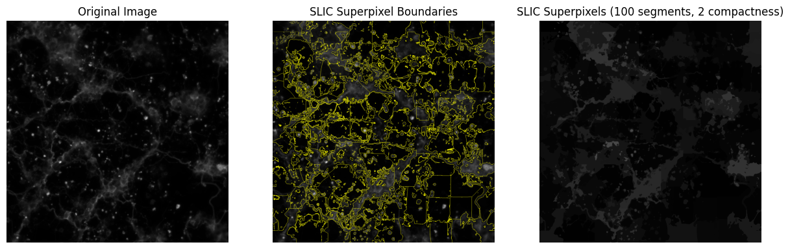
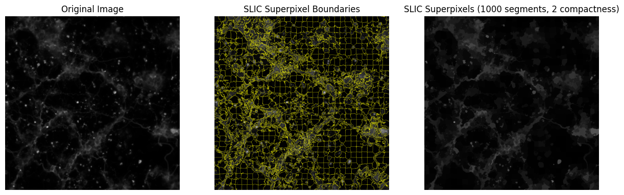
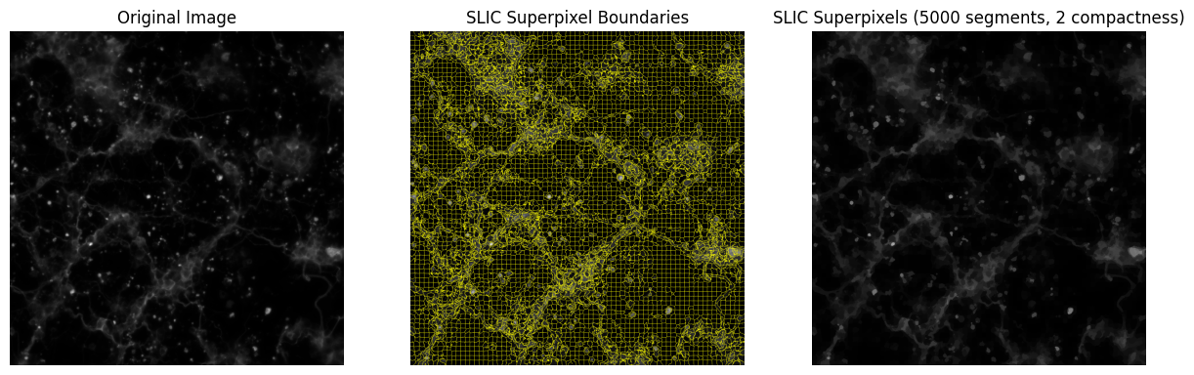
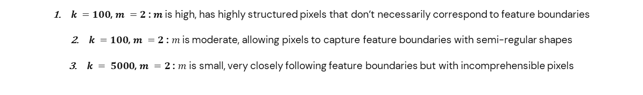
SLIC — Balancing $k$ and $m$
Super-Pixelization: SLIC Algorithm
$k =100$, $m =2$ : $m$ is high, has highly structured pixels that don’t necessarily correspond to feature boundaries
$k =100$, $m =2$ : $m$is moderate, allowing pixels to capture feature boundaries with semi-regular shapes
$k = 5000$, $m =2$ : $m$ is small, very closely following feature boundaries but with incomprehensible pixels

Slide 33
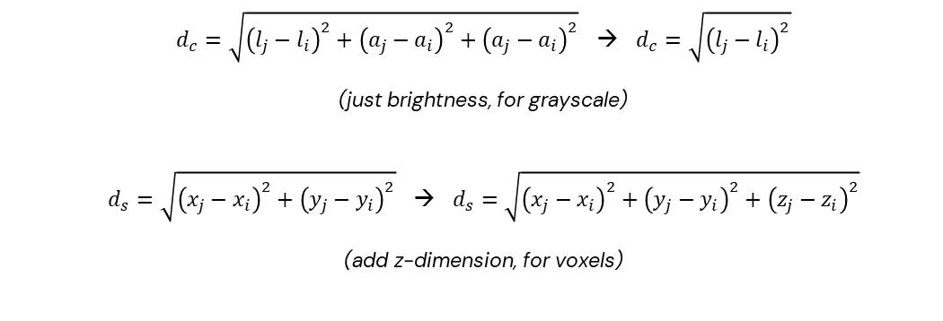
SLIC — Further Considerations
Super-Pixelization: SLIC Algorithm
SLIC can be done on grayscale images, or 3D voxels by taking away color dimensions and adding a spatial dimension to distance calculations:
SLIC does not explicitly enforce connectivity!
→ At the end of the clustering procedure, some “orphaned” pixels that do not belong to the same connected component as their cluster center may remain.
→ To correct for this, such pixels are assigned the label of the nearest cluster center using a connected components algorithm.
$d_{c}=\sqrt{{\left(l_{j}−l_{i}\right)}^{2}+{\left(a_{j}−a_{i}\right)}^{2}+{\left(a_{j}−a_{i}\right)}^{2}}$ → $d_{c}=\sqrt{{\left(l_{j}−l_{i}\right)}^{2}}$
(just brightness, for grayscale)
$d_{s}=\sqrt{{\left(x_{j}−x_{i}\right)}^{2}+{\left(y_{j}−y_{i}\right)}^{2}}$ → $d_{s}=\sqrt{{\left(x_{j}−x_{i}\right)}^{2}+{\left(y_{j}−y_{i}\right)}^{2}+{\left(z_{j}−z_{i}\right)}^{2}}$
(add z-dimension, for voxels)

Slide 34
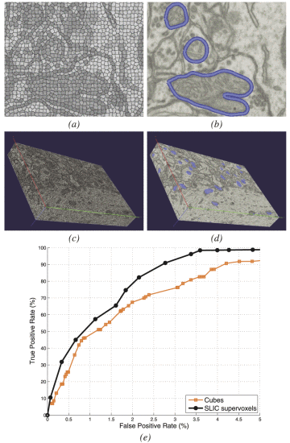
SLIC — Further Considerations
Super-Pixelization: SLIC Algorithm
An example of application in biomedical imaging – mitochondria segmentation from electron micrographs (EM)
Large images where reducing the resolution is not an option: segmentation via graph cuts over pixel-grid would be intractable
Quickly create supervoxels and proceed with graph cut
SLIC superpixels from an EM slice
Segmentation via graph-cuts on pixels
SLIC supervoxels on a 1,024×1,024×600 volume
Extracted Mitochondria from supervoxels
Segmentation performance comparing SLIC supervoxels versus cubes of similar size for the volume in (c).
Achanta, R., Shaji, A., Smith, K., Lucchi, A., Fua, P., & Süsstrunk, S. (2012). SLIC Superpixels Compared to State-of-the-Art Superpixel Methods. IEEE Transactions on Pattern Analysis and Machine Intelligence.

Slide 35
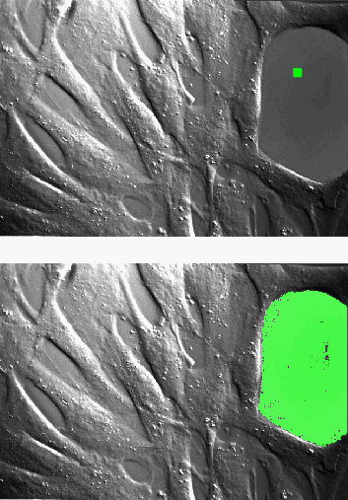
Region Growing
Start at a point in a region and expand outward within that region.
Process
Choose the initial point (seed) in an image within the area you want to isolate.
Compare distance of surrounding pixels in RGB-space individually.
If the distance is less than a designated threshold, that pixel is added to the queue.
If greater, do not add to processing queue.
Repeat until queue is empty.
Note that distance is still the usual Euclidean distance metric!
NV5 Geospatial Software Documentation, 2024,
https://nv5geospatialsoftware.com

Slide 36
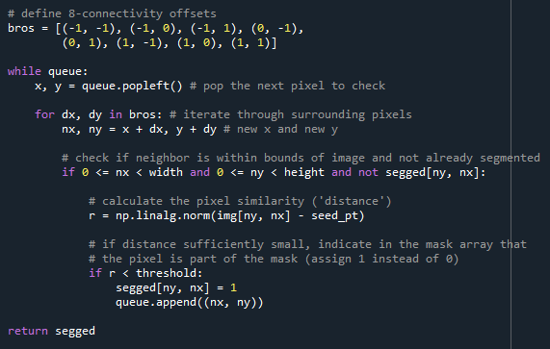
Region Growing – Main Loop

Slide 37

Region Growing - Concept

Slide 38

Region Growing - Concept

Slide 39

Region Growing - Concept

Slide 40

Region Growing - Concept

Slide 41

Region Growing - Concept

Slide 42

Region Growing– Application

Slide 43

Region Growing– Application

Slide 44

Region Growing– Application

Slide 45

Region Growing– Application

Slide 46

Region Growing– Application

Slide 47

Region Growing– Application
Threshold = 30.0

Slide 48

Region Growing– Application
Threshold = 15.0

Slide 49
Region Growing – (Dis)Advantages
Intuitively simple – Start with a seed pixel and choose whether or not to add neighbor pixels based on a criterion determined by the seed.
Contiguous regions – Everything determined to be in a segment are connected based on your criterion.
Respects edges.
Handles (some) noise fairly well.
Highly sensitive to initial seed and threshold.
Possibly computationally expensive due to iterative process.
Difficulty with complex structures.

Slide 50
Pipeline: SLIC + Region Growing
One example of how SLIC can be applied in a segmentation pipeline is in conjunction with region growth
Instead of conducting region growth on the original image, with potentially large local variations, conduct image growth on Superpixels
Leads to more robust, stable, and (potentially) faster segmentation
Simple segmentation pipeline:
Use SLIC to create “appropriate” superpixels/superpixel boundaries
Create superpixelated image, (say, take average color/intensity of all pixels inside a superpixel)
Run region growth on superpixelated image
Overlay segmentation boundaries on original image

Slide 51

Region Growing without SLIC
With “stable” regions for seed point, segmentation is consistent
Blinds work very well with region growth
On more chaotic regions, segmented regions vary more based on seed point, even when seed points are close together
Region growth is very sensitive to local variations within the same segment
Different segments for Laney’s chest

Slide 52


Region Growing with SLIC

Slide 53



Region Growing without SLIC
Not only can region growing be more robust with superpixelization, it can also be quicker!
Alter boundary checking from neighboring pixels to neighboring superpixels
Depending on amount of superpixels, vastly reduces amount of computations
Example: neuron segmentation
Time taken for region growing without superpixels: 3.10 seconds
Time taken for region growing with superpixels: 0.417 seconds
(1000 segments, $m$ = 0.05)

Slide 54
References
1. Achanta, R., Shaji, A., Smith, K., Lucchi, A., Fua, P., & Süsstrunk, S. (2012). SLIC Superpixels Compared to State-of-the-Art Superpixel Methods. IEEE Transactions on Pattern Analysis and Machine Intelligence.
2. Dey, S., (2016). Kernel K-Means, K-Means++ and Cluster Evaluation. https://sandipanweb.wordpress.com/2016/08/29/kernel-k-means-and-cluster-evaluation/

